Slide 1
VIRS 2.0 Team Members: Alfredo Lopez, Milad Ebrahimi Product Owners: Eric Dwyer, Seyedjafar Ehsanzadehsorati Professor: Masoud Sadjadi School of Computing and Information Sciences Florida International University
Senior Project Final Presentation Fall 2017
Notes:
Greet your audience, thank them for attending your presentation, introduce yourself, introduce your project, introduce your team members, and quickly indicate what each of you did in a high-level manner, and put more emphasis on your part/contribution.

Slide 2
Problem definition
Problem:
One of the major challenges that English Language learners (ELL) as well as mainstream students face is the lack of a reliable source to improve their academic words. There is no easy way to validate the easiness of text, which allows professors to select the appropriate materials for class. A challenging text is a wonderful way to propel students forward, yet something too hard to read can cause the opposite effect.
Notes:
Introduce the problem that the whole project tackles and stay focused on the parts that you have been working. Indicate if there is an existing previous system, enumerate its problems/limitations, etc.

Slide 3
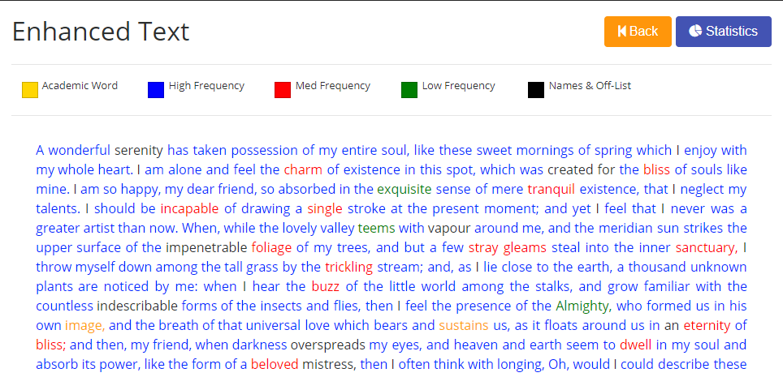
Project definition
An application that produces enhanced texts through a color-coded system.

Slide 4
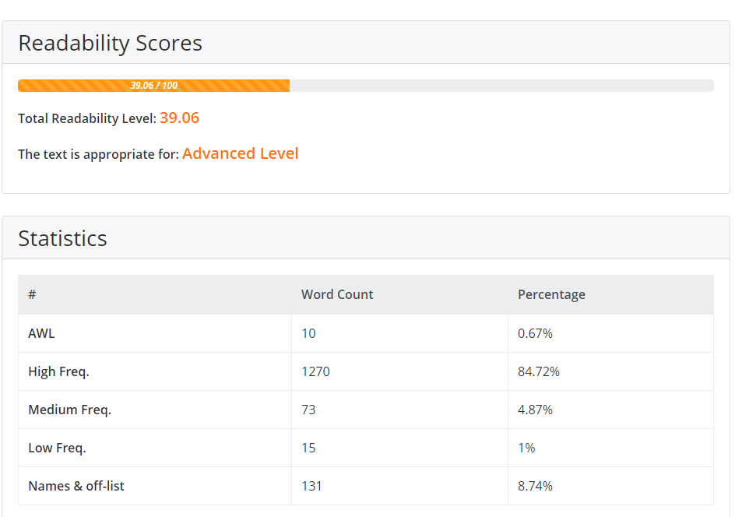
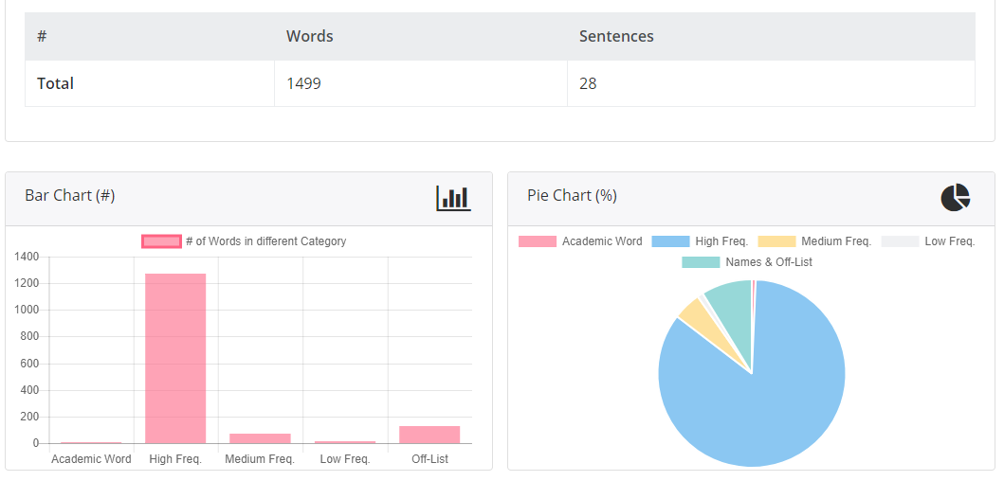
Project definition
Provides reliable readability index that would help teachers in decisions making gives a detailed analysis of texts that would help in material development.

Slide 5
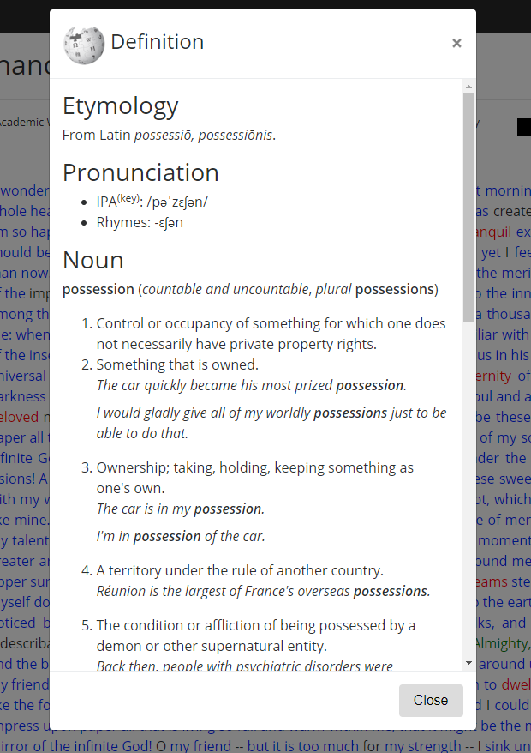
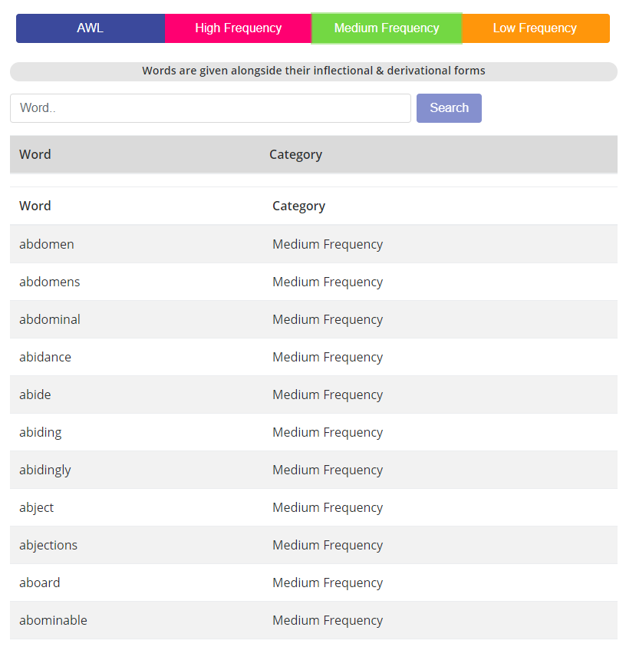
Project definition
The Wikipedia definition for the word will be displayed when clicking a word.
A new frequency-based dictionary that makes it easier to read.

Slide 6
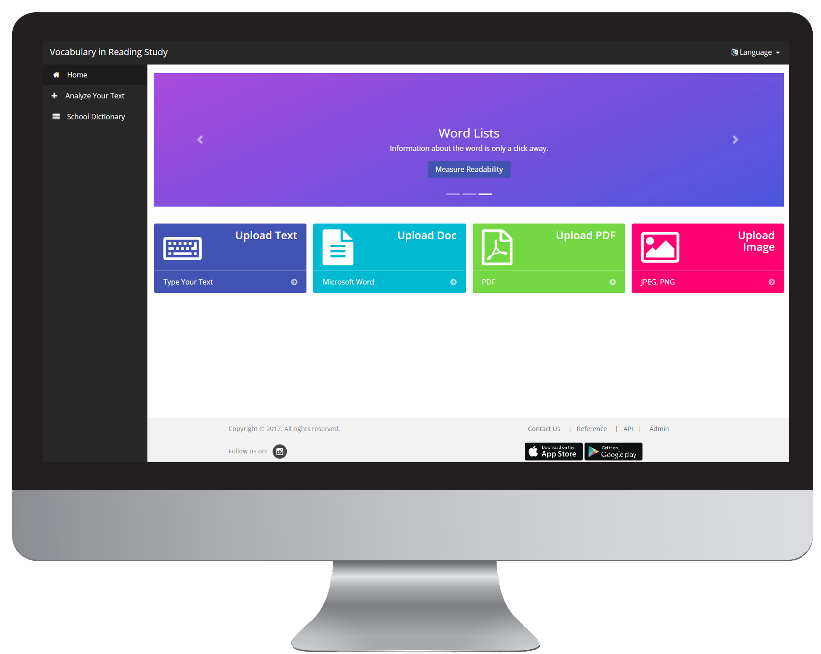
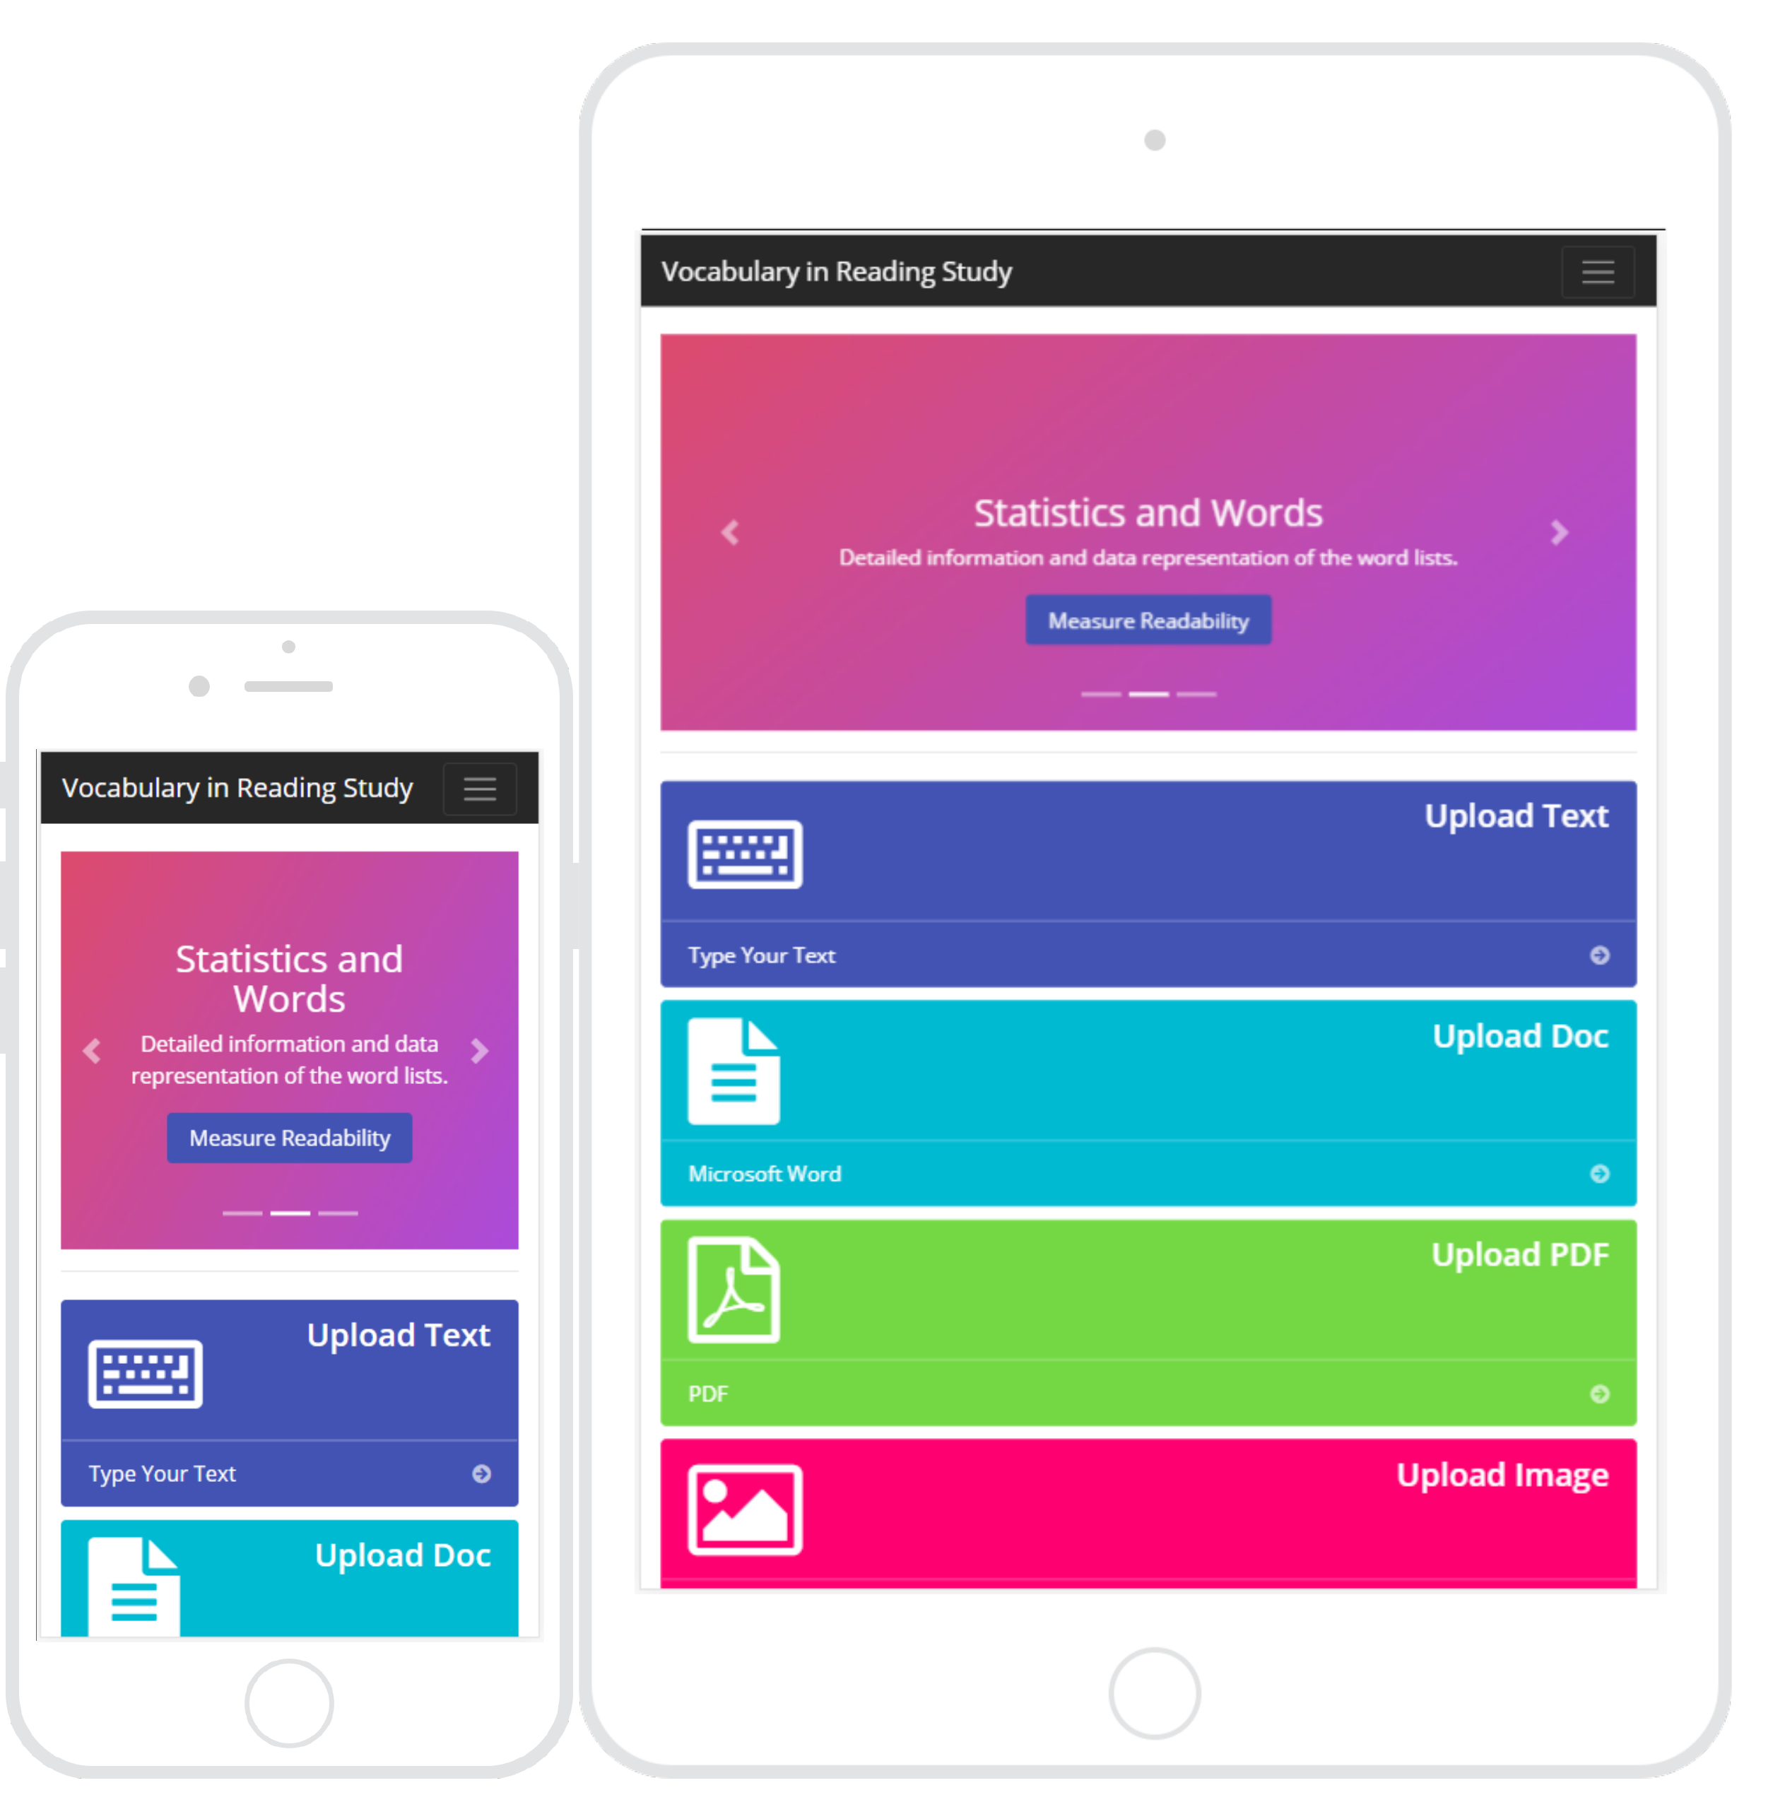
Project definition
The web application that is accessible from desktops, tablets and mobile devices.

Slide 7
Project Management
Notes:
Project Management (schedule for entire semester) (one slide; Gantt Chart).

Slide 8
Requirements: User Stories
132 [Backend] Perform OCR
145 [Backend] Analyze Text
146 [Backend] Analyze PDF
147 [Backend] Analyze Doc
148 Implement Responsive Design
149 Merge Applications
150 [Frontend] Create Admin Panel
151 [Backend] Implement Word Definition
154 [Frontend] Create Sidebar Menu
155 [Frontend] Apply Category Color to Words
157 Implement Google Analytics
158 [Backend] Create Admin Login
176 [Frontend] Analyze Text
178 [Frontend] Analyze PDF
179 [Frontend] Analyze Doc
Notes:
4. Requirements:
4.1. User stories implemented (one or more slides).
4.2. UML use cases and the use case diagram for the implemented use cases (one or more slides).
4.3. UML sequence diagrams for the implemented use cases.

Slide 9
Requirements: User Stories
181 [Backend] Manage words list
182 Create cloud application
183 [Frontend] Create page for enhanced
184 [Frontend] Create page for statistics
185 [Frontend] Create instructions
214 [Frontend] Analyze Image
220 [Frontend] Create Word Lists page
222 [Frontend] Implement Word definition
223 [Frontend] Add Credits Page
224 [Frontend] Add Contact Us Page
225 [Backend] Calculate Statistics
227 [iPhone] Create iPhone Application
228 [Android] Create Android Application
243 Create Search API

Slide 10
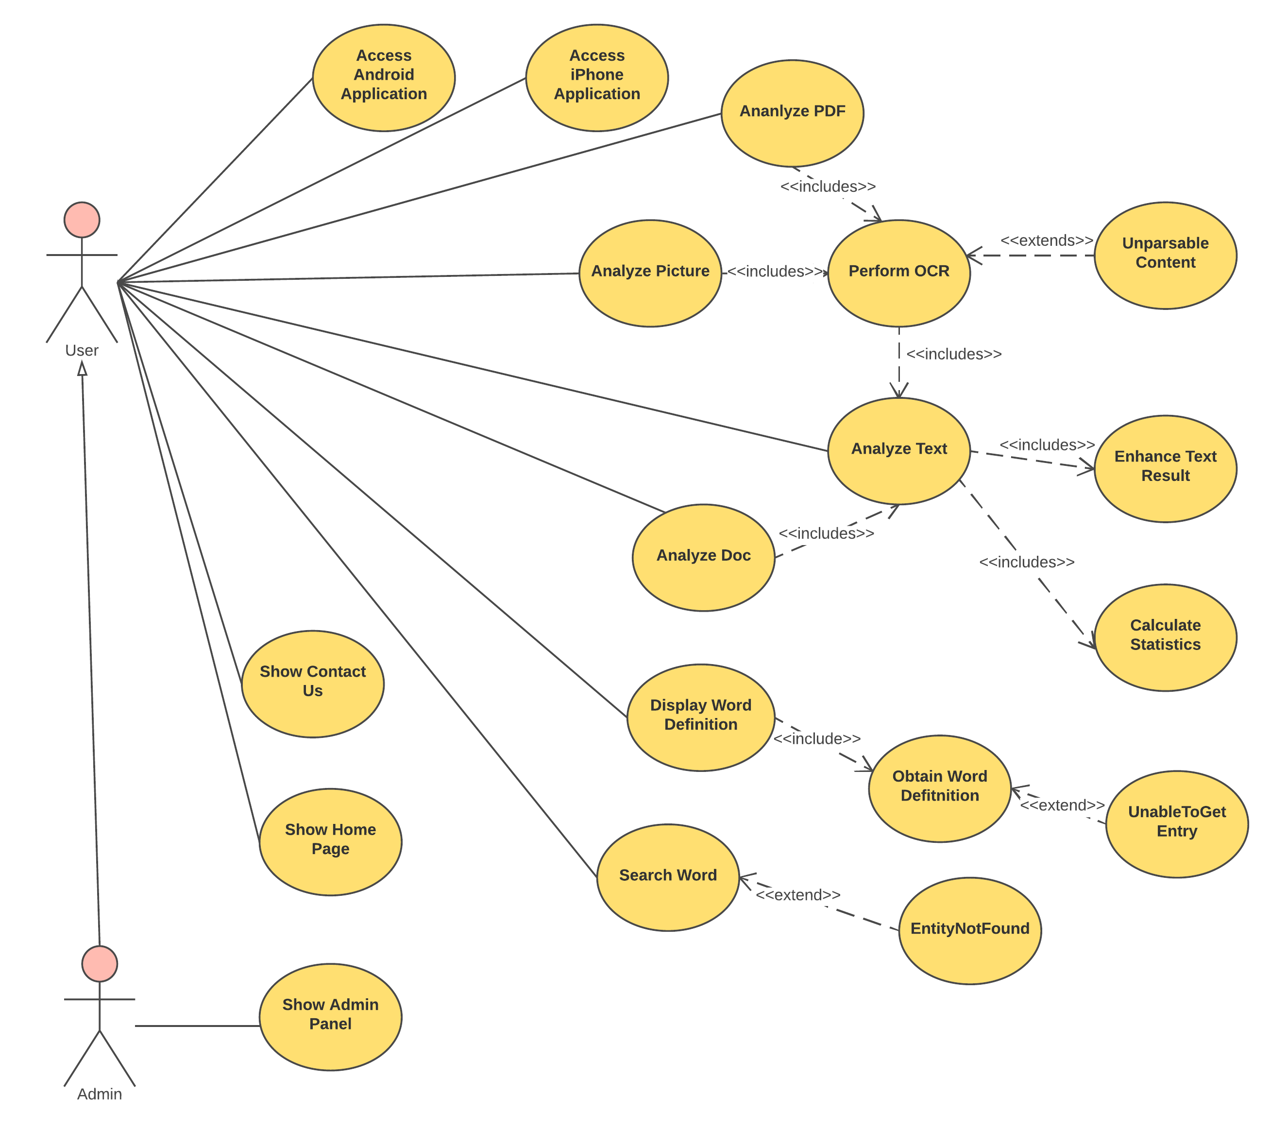
Requirements: Use Cases
Notes:
4. Requirements:
4.1. User stories implemented (one or more slides).
4.2. UML use cases and the use case diagram for the implemented use cases (one or more slides).
4.3. UML sequence diagrams for the implemented use cases.

Slide 11
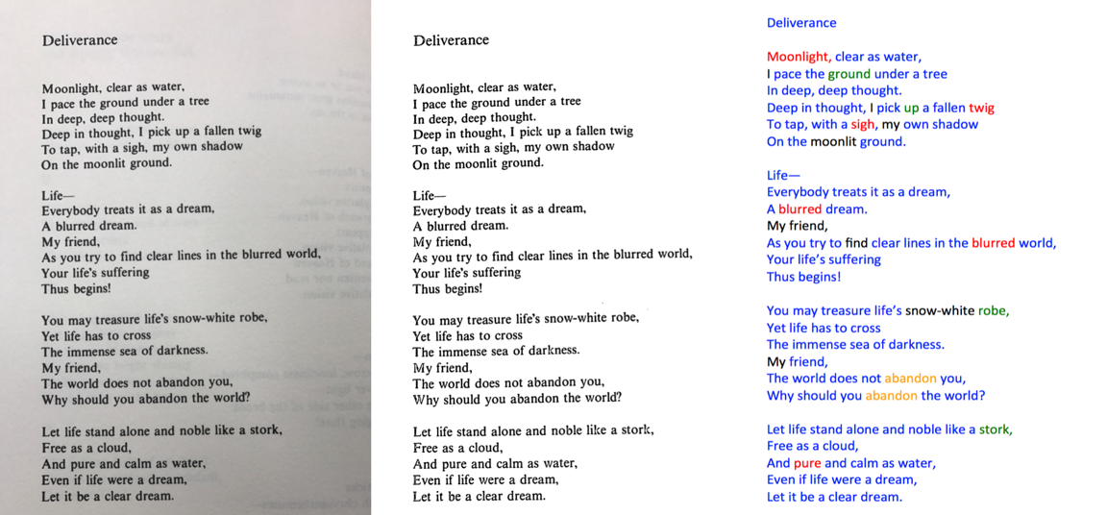
User Story: #132 Perform OCR
As a user, I want to see the words and their different categories from an image file so that I can know more about the words in the image.

Slide 12
Use Case: #132 Perform OCR
Name: Perform OCR Actor: User Preconditions: The user has the desire to know more information about words in a picture. Description <Flow of events>: -The user interacts with systems and chooses a picture -The user sends the information -The system receives the information and process it -The system displays the information. -The use case ends -Alternative: The user receives an unparsable exception.

Slide 13
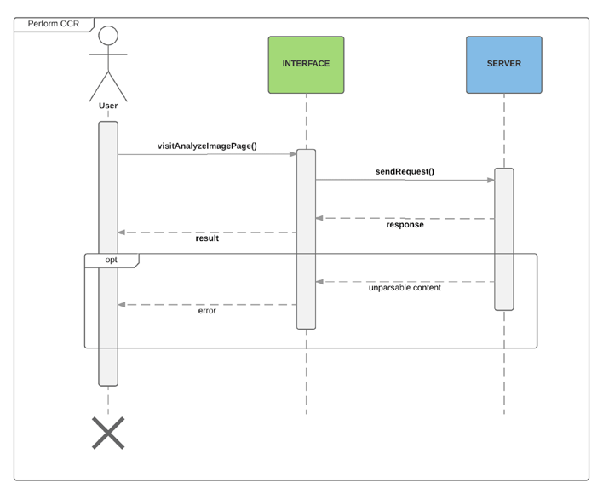
Requirements: Sequence Diagrams
Notes:
4. Requirements:
4.1. User stories implemented (one or more slides).
4.2. UML use cases and the use case diagram for the implemented use cases (one or more slides).
4.3. UML sequence diagrams for the implemented use cases.

Slide 14
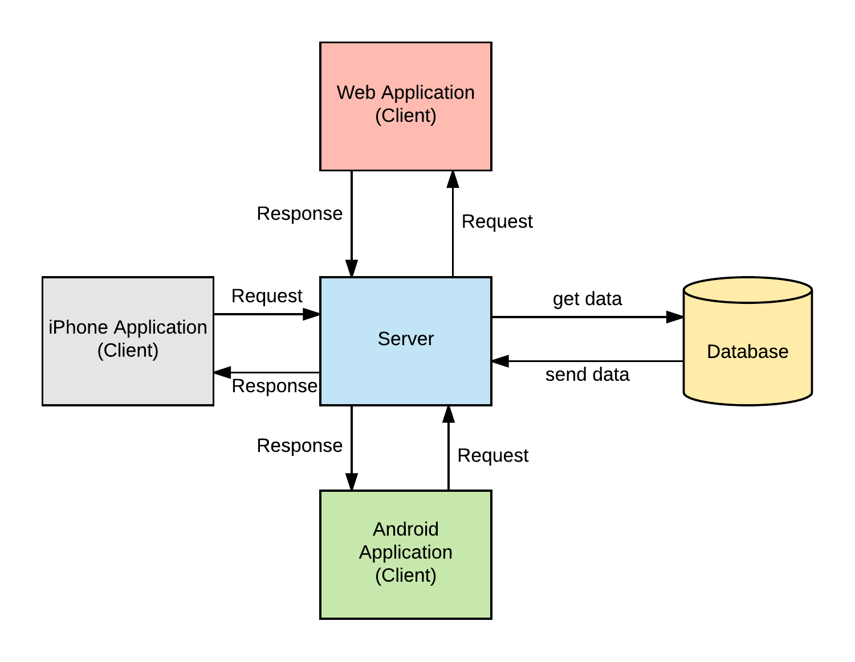
System Design: Architecture
Model-View-Controller
Notes:
5. System design:
5.1. System decomposition; identify the architecture patterns used (one slide).
5.2. System deployment – h/w and s/w requirements (one slide).
5.3. Persistent data design (one slide).
5.4. Security/Privacy (one slide).

Slide 15
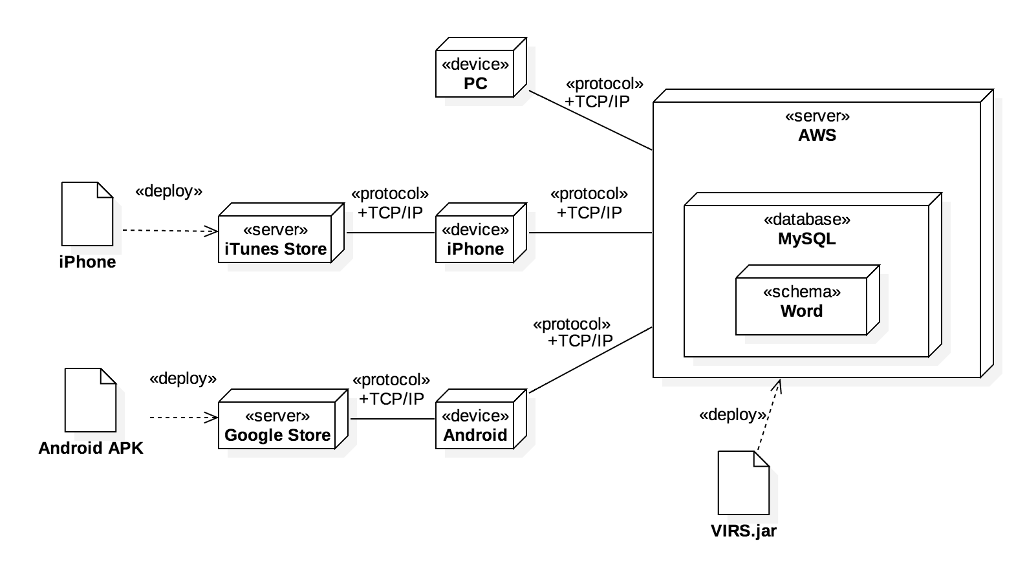
System Design: Deployment
Notes:
5. System design:
5.1. System decomposition; identify the architecture patterns used (one slide).
5.2. System deployment – h/w and s/w requirements (one slide).
5.3. Persistent data design (one slide).
5.4. Security/Privacy (one slide).

Slide 16
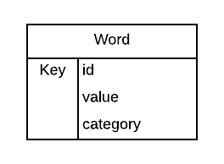
System Design
Persistent data design
The data layer consists in a single table with all the data.
Security/Privacy
All keys are encrypted using Jasypt.
The Administrator keys are all secured.
Notes:
5. System design:
5.1. System decomposition; identify the architecture patterns used (one slide).
5.2. System deployment – h/w and s/w requirements (one slide).
5.3. Persistent data design (one slide).
5.4. Security/Privacy (one slide).

Slide 17
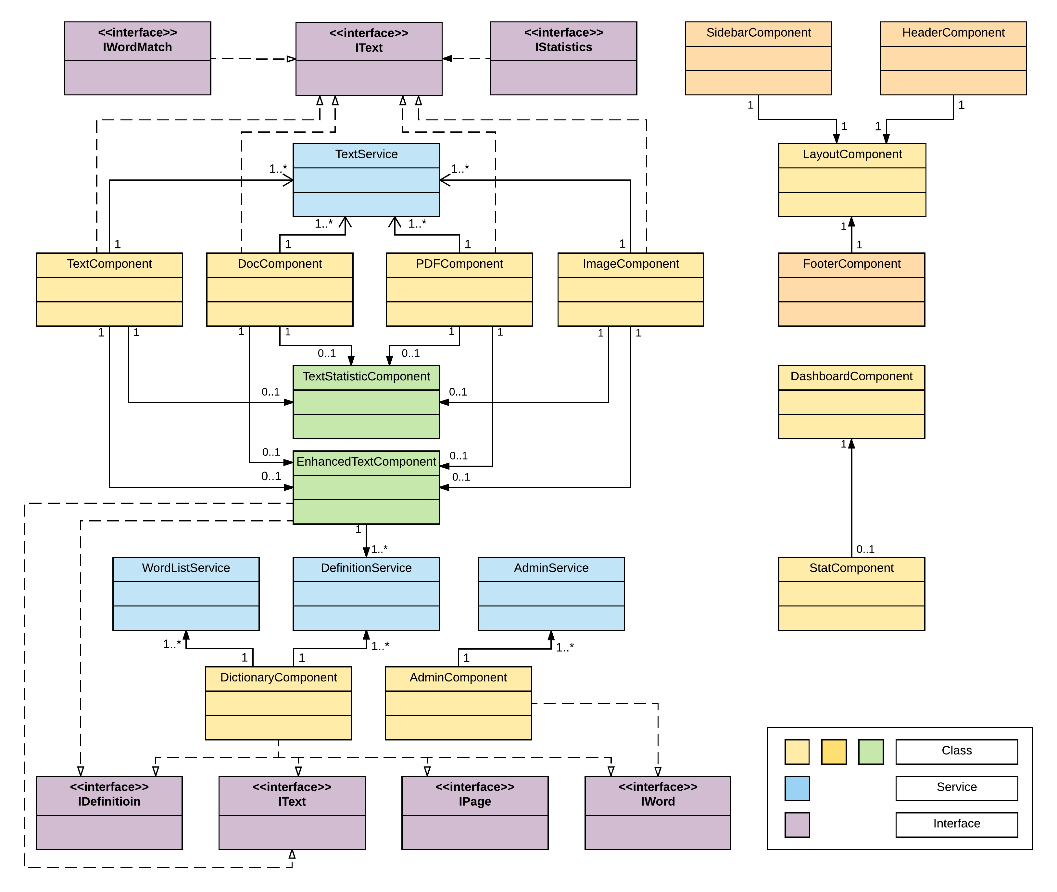
Minimal Class Diagram: Frontend
Notes:
6. Detailed design:
6.1. Minimal class diagram. Identify the design patterns used (one or more slides).
6.2. State machine for the main control object or the most important object of the implemented uses cases (one or more slides).
6.3. Main algorithm used related to an implemented use case described above (one or more slides).

Slide 18
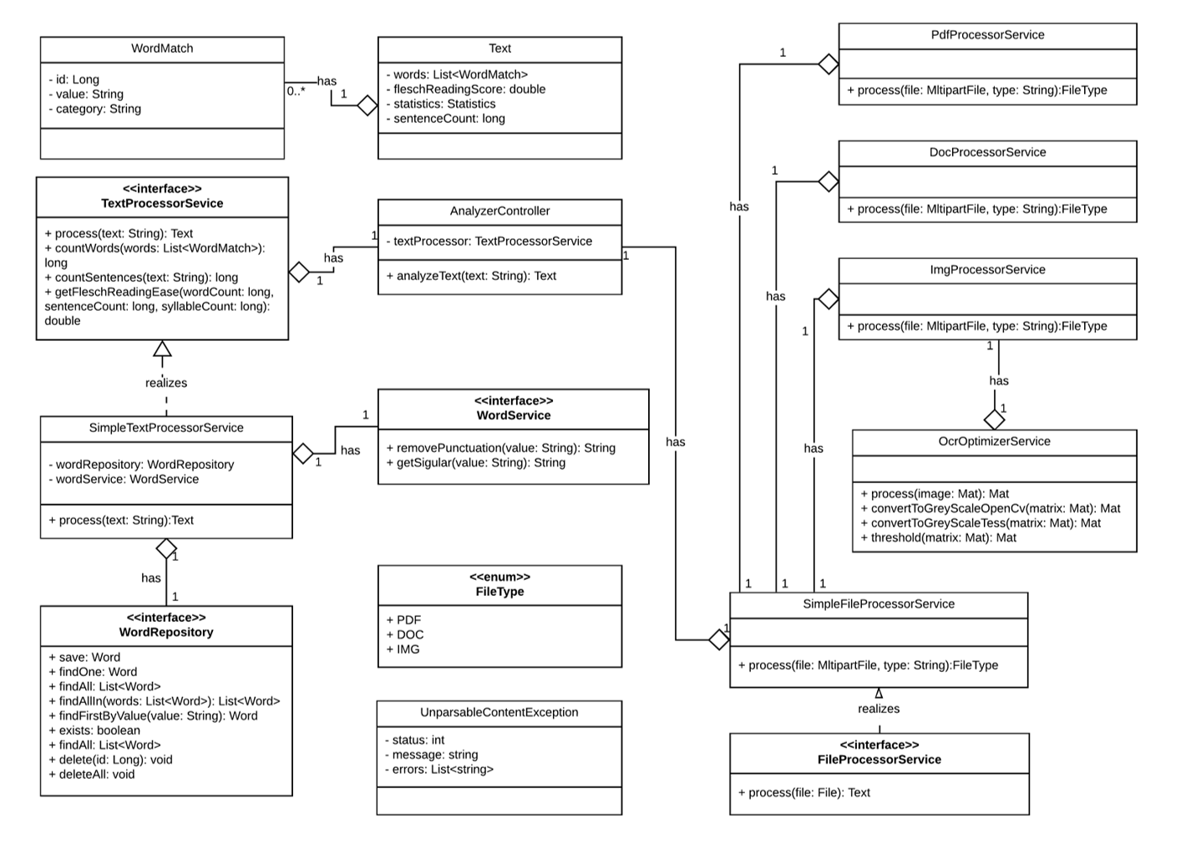
Minimal Class Diagram: Backend

Slide 19
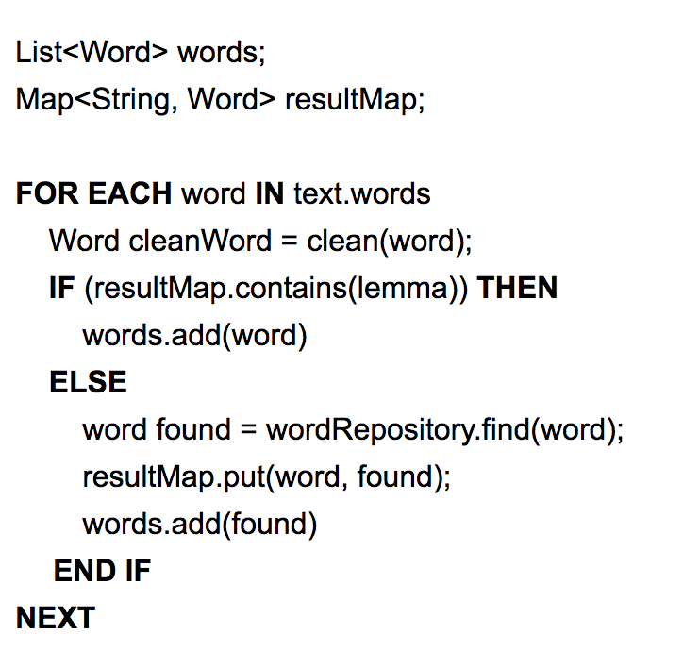
Main algorithm
Notes:
6. Detailed design:
6.1. Minimal class diagram. Identify the design patterns used (one or more slides).
6.2. State machine for the main control object or the most important object of the implemented uses cases (one or more slides).
6.3. Main algorithm used related to an implemented use case described above (one or more slides).

Slide 20
Test Suites and Test Cases
Junit was the main tool utilized to verify the system.
Implemented several integration tests that are run before deploying to the web.
Karma and Jasmine were used to perform unit testing for frontend.
Compodoc and Istanbul were used to generate a code coverage report.

Slide 21
Test Suites and Test Cases
Test case ID: getFleschReadingEase_WithDataFromWebSite_Returns60_20
Description/Summary of Test: Getting the Flesch Reading Score with word count of 300, a sentence count of 12 and a syllable count of 430 returns 60.20.
Pre-condition: None
Expected Results: A reading score of 60.20
Actual Result: A Reading score of 60.20
Status (Fail/Pass): Pass
Notes:
7. Test Suites and Test Cases (one sunny day and one rainy day) for the use case represented in part (5) above (2 slides).
7.1 One sunny day and one rainy day for the implemented use cases (one or more slides).
7.2 Automated test scripts for the implemented use cases (one or more slides).

Slide 22
Test Suites and Test Cases
Test case ID: TextComponent_ShouldCreate_001
Description/Summary of Test: The Text component should be created.
Pre-condition: The server must be running.
Expected Results: Test Component should be created
Actual Result: Test Component was created
Status (Fail/Pass): Pass

Slide 23









Summary
Summary:
VIRS is a web app which facilitates learning of new languages through analysis of text and gathering of data which is then displayed to the user. Data given to the user includes category of word as far as popularity and definition of the words in the text with respect to the information in the database. It also provides the user with a complete statistical text analysis report and readability score.
contact information
Alfredo Lopez: alfredo.lopez002@gmail.com
Milad Ebrahimi: milad19@gmail.com
Questions?
Thank You!
Notes:
Summarize your contribution
Include your contact information
Ask if anyone has any questions for you.
Thank your audience

